Slide 1

Design of Language Translator APP
Pratham Bajpai
(0901EO211043)

Slide 2

INTRODUCTION
1. Develop a user-friendly language translator app that supports over 50 languages.
2. Implement offline translation capabilities for uninterrupted usage without an internet connection.
3. Enhance the user experience with an engaging animated splash screen.

Slide 3
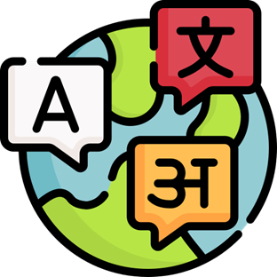
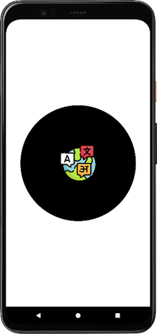
Animated Splash Screen Integration

Slide 4
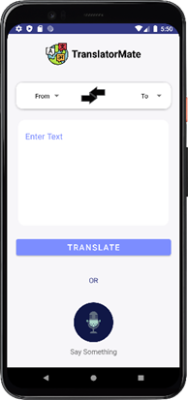
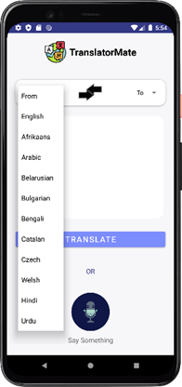
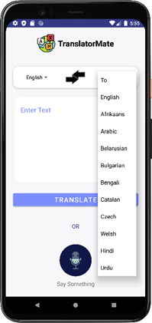
User Interface Design

Slide 5
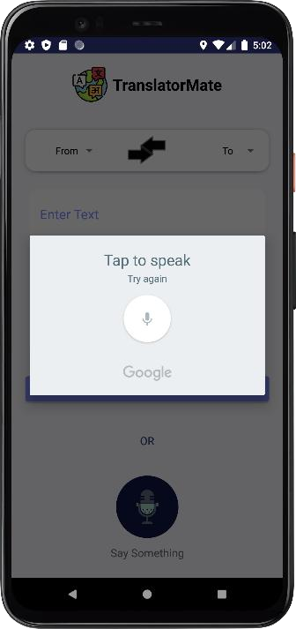
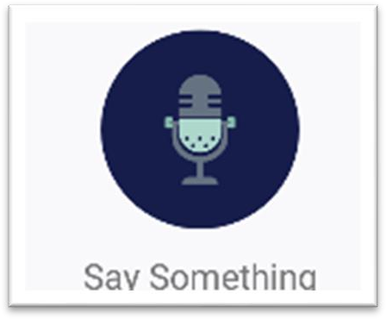
Voice Translation Integration

Slide 6
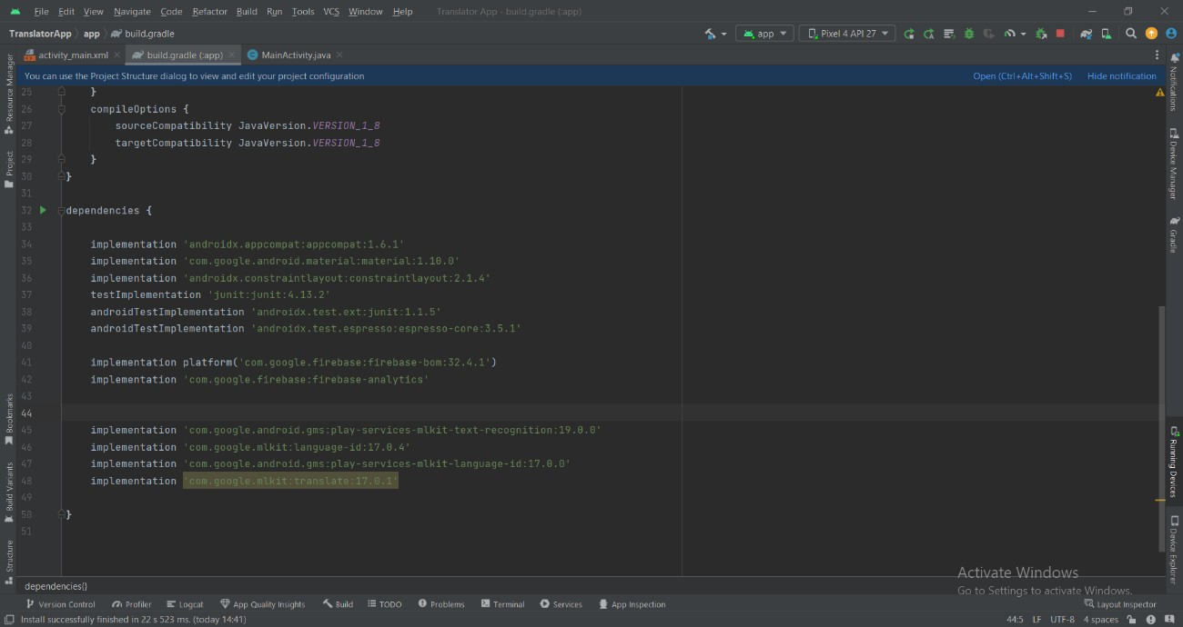
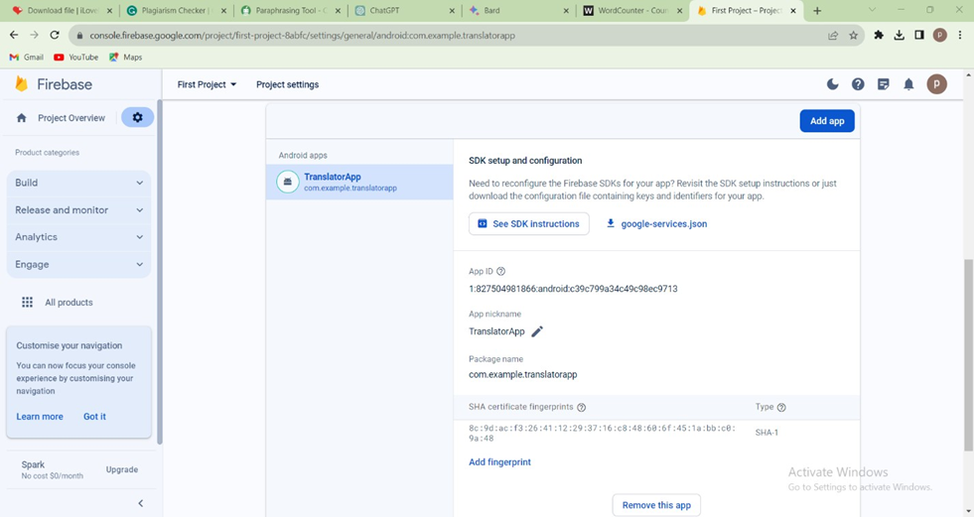
API Integration Implementation
Development of Offline Functionality using Firebase Services

Slide 7

Plan future enhancements
Dictionary Activity
Feedback Mechanism
Conversation Chatbot, and
Image-Based Translation.

Slide 8

THANK YOU

